Slide 1
ROC and Precision-recall curves
Classification
Meunier Jean-Christophe
Last updated: March 12, 2022

Slide 2
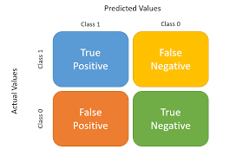
Confusion matrix

Slide 3
Confusion matrix
X
Objective of any classification task:
reaching highest rates of true values
X

Slide 4


Receiver operating characteristic (ROC)
TPR = TP amongst all REal positive (TP+FN)
 |  | Predicted value
 |  | A | B
Actual value | A | 45 | 15
 | B | 13 | 27
Or
Proportion of ‘sicks’ correctly labelled
FPR = FP amongst all real negative (FP+TN)
Or
Proportion of ‘non-sicks’ incorrectly labelled as sick
Threshold
Set by default at 0,5 in binary hard classification

Slide 5
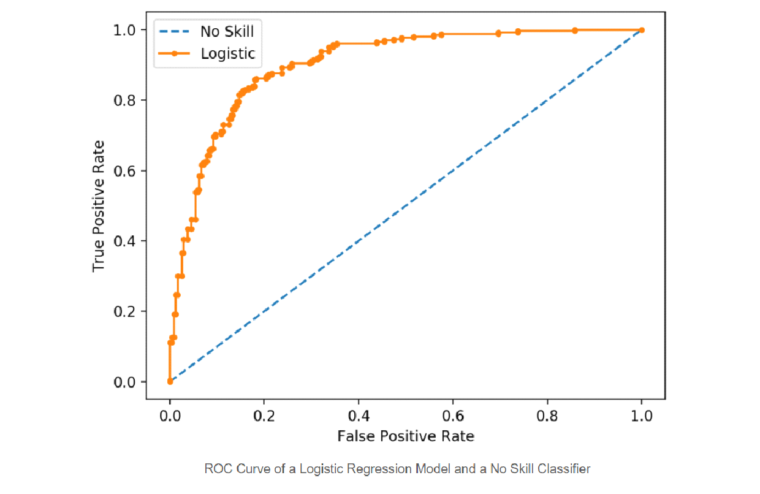
Receiver operating characteristic (ROC)
Threshold = 0,0
Every observation is labelled as positive
Good threshold
TPR = 0,8 : 80% of positives have been positively labelled
FPR = 0,17 : with less than 20% of negatives being positively labelled
TPR = 1,0 : all positive have been positively labelled
FPR = 1,0 : but all negative have also been positively labelled
No skill’s curve
Whatever the real status (sick or not), the chance of being labelled as ‘sick’ is the same
Threshold = 1,0
No observation is labelled as positive
Rem : based on soft classification i.e. class probabilities

Slide 6


Precision-Recall
 |  | Predicted value
 |  | A | B
Actual value | A | 45 | 15
 | B | 13 | 27
REcall (=TPR) = TP amongst all REal positive (TP+FN)
PREcision = TP amongst all PREdicted positive (TP+FP)
Threshold
Set by default at 0,5 in binary hard classification

Slide 7
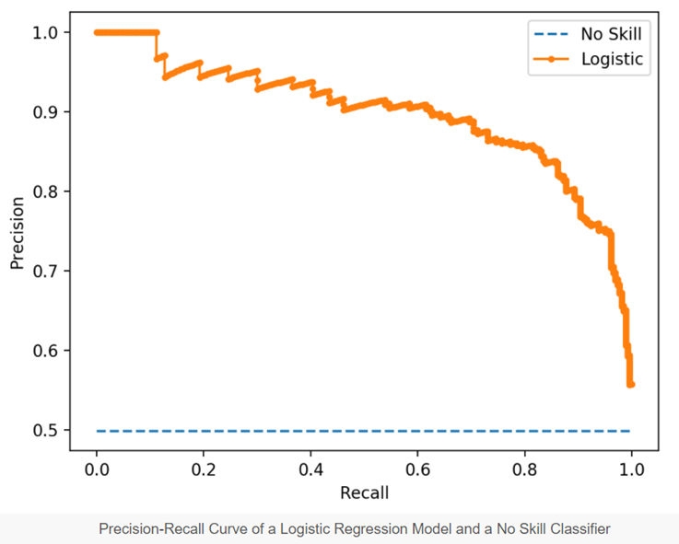
Precision-recall
Precision = 1,0 : all the few positive labels that have been done are TP
Recall = 0,18 : but many other real positive have been negatively labelled
Threshold = 1,0
No observation is labelled as positive
Precision = 0,65 : amongst the positive labels, 45% are FP
Recall = 1,0 : but real positive have been correctly labelled
No skill’s curve
Whatever the real status (sick or not), the chance of being labelled as ‘sick’ is the same
Threshold = 0,0
Every observation is labelled as positive

Slide 8
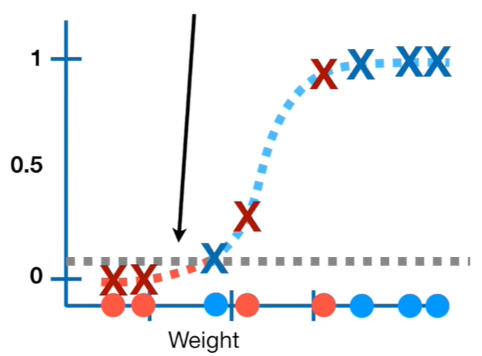
Index behavior by threshold (thr = 0,1)
TPR/ Recall = 1,00 : 100% of the real positive have been positively labelled
FPR = 0,50 : 50% of the negative have been positively labelled
Precision = 0,66 : amongst the positive labels, 66% are TP

Slide 9
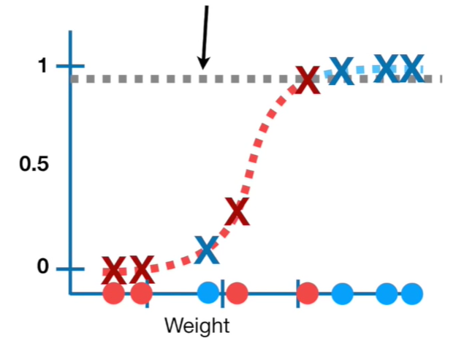
Index behavior by threshold (thr = 0,9)
TPR/ Recall = 0,75 : 75% of the real positive have been positively labelled
FPR = 0,20 : 20% of the negative have been positively labelled
Precision = 1,00 : amongst the positive labels, 100% are TP

Slide 10
Balanced vs. unbalanced classes
ROC curves should be used when there are roughly equal numbers of observations for each class.
Precision-Recall curves should be used when there is a moderate to large class imbalance.

Slide 11
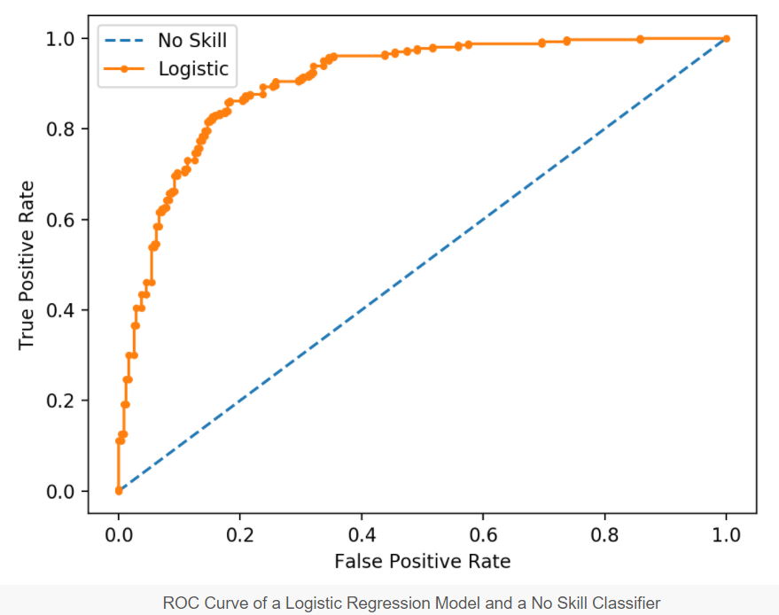
Balanced classes
ROC

Slide 12
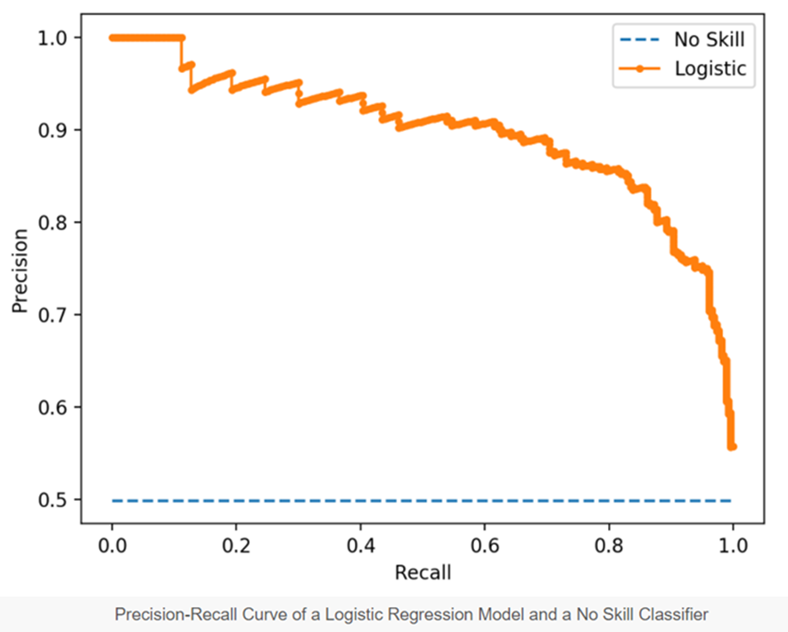
Balanced classes
Precision-recall

Slide 13
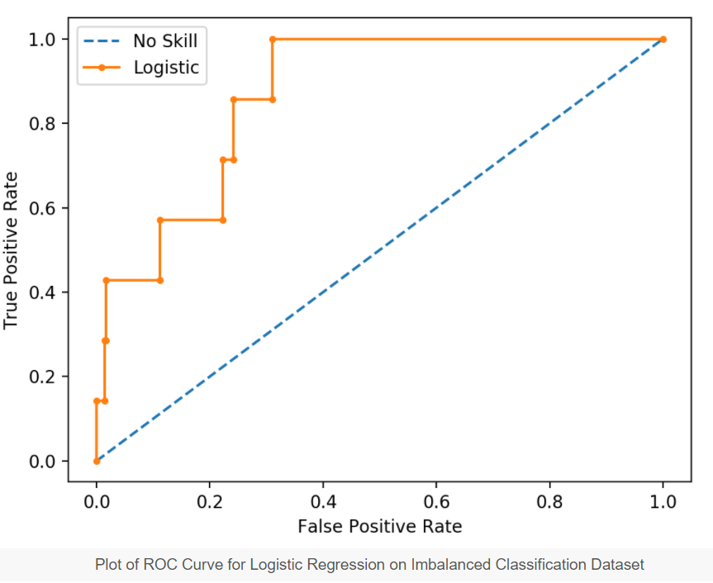
Unbalanced classes
ROC

Slide 14
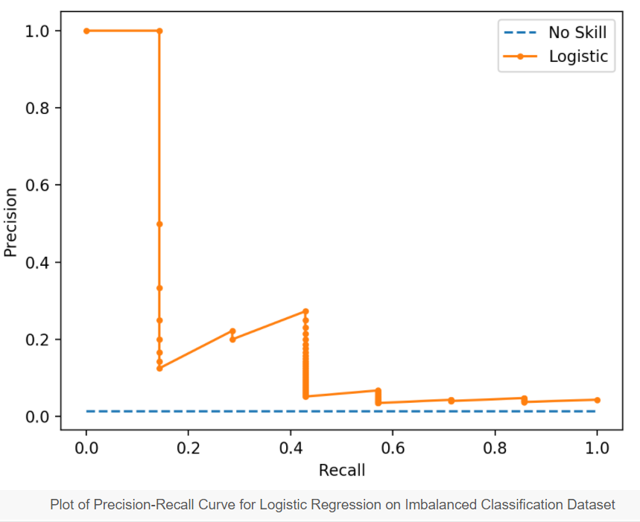
Unbalanced classes
Precision-recall
If ‘positive’ is a very minority class (e.g. 5%) :
Precision decreases rapidly
as
# of negative incorrectly labelled as positive increases rapidly
Here all real positive have been taken into account
But many many of the positive labels are in fact negative

Slide 15
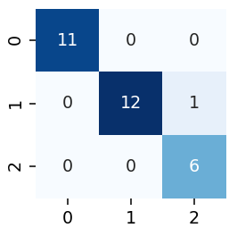
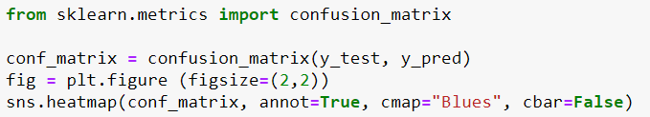
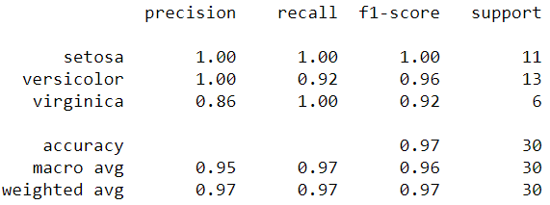
Multiclass classification
Predicted
Values
FP
Actual
Values
TP
FN
cells size
Simple mean
Mean weighted by cells size

Slide 16
Practical illustration
See jupyter notebook : https://github.com/jcmeunier77/Data_visualization/blob/master/Visualizing%20ROC%20and%20precision-recall%20curve%20with%20thresholds.ipynb

